Slide 1

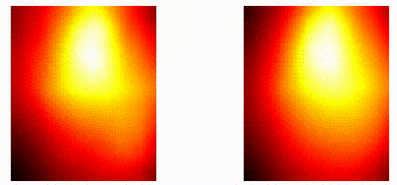
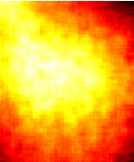


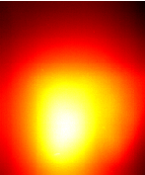
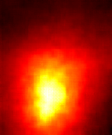
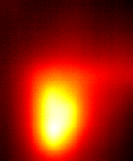
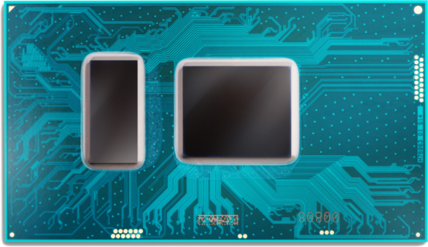
Real Case Study
We further test the real-time estimation ability of ThermGAN by running it on a brand-new workload.
7200 samples were collected and ThermGAN yields an average RMSE of 0.83°C with a standard deviation of 0.52°C.
Estimated
Ground Truth
Estimated
Ground Truth
Estimated
Ground Truth
Estimated
Ground Truth

